Slide 1
Internet protocol (part 4: Routing)
Rocky K. C. Chang
Chung Yuan Christian University
Dept. Information and computer engineering
March 29, 2023

Slide 2
The routing problem
Problem: How can a router/host determine the path to a destination (i.e., the route)?
Any routing protocol must allow routers to make a corporate, consistent, and correct local forwarding decisions regarding any destination in a global routing fabric.
  Sources and destinations are generally not directly connected.
  Routers are generally not directly connected.

Slide 3
Design issues
Scalability: scale to the number of networks
  Routing table size
  Routing messages
  Time to converge
Free of permanent/transient routing loops
Optimal paths: hop count, type-of-service, quality-of-service, etc.
Security
Host mobility and perhaps router mobility

Slide 4
Design choices
Centralized vs decentralized
  A central processor computes the routes.
Source-based vs hop-by-hop
  E.g., source routing and destination-based routing
With or without the global topological info.
  E.g., OSPF vs RIP
Dynamic (or state-dependent) vs static routing
  IP routing vs ATM routing
Single-path vs multiple path

Slide 5
Levels of routing
Intra-domain routing (inside AS) vs inter-domain routing (inter-AS)
AS: Autonomous system (AS number or ASN)
Not all routers are equal.
  Interior routers: Only know how to route datagrams to destinations within the same AS.
  Border routers: Interface between its AS and other AS’s:
    A nonbackbone router usually has a “default route” to another “more knowledgeable” router for “unknown destinations.”
    A default-free router is supposed to know every “IP network” in the Internet.

Slide 6
Autonomous system
Autonomous system (AS): A set of networking resources governed by a single administrative authority.
AS’s can be classified into
  Stub AS: has only a single connection to one other AS, and it only carries local traffic.
  Multihomed AS: has connections to more than one other AS, but refuses to carry transit traffic.
  Transit AS: has connections to more than one other AS, and is designed to carry both transit and local traffic.
AS number: 1659 for TANet and 4616 for PolyU
Nodes: AS; links: peer-peer, provider-consumer

Slide 7
Exercise 1
Traceroute to 103.16.128.2 and find out how many ASes are involved. Find out their ASNs.
These tools are useful:
  http://whois.tanet.edu.tw/
  https://www.whatismyip.com/ip-whois-lookup/
  https://hackertarget.com/as-ip-lookup/
  https://www.ipvoid.com/ip-to-asn/ (use this for IP→ASN)

Slide 8
Exercise 2
Perform traceroute from https://perfops.net/traceroute-from-australia (Brisbane) to your machine.
What are the similarities and differences between this reverse traceroute and the forward traceroute obtained in the last slide?

Slide 9
Exercise 3
Repeat the last two exercises for www.net.princeton.edu.
The reverse traceroute can be performed from https://www.net.princeton.edu/traceroute.html.

Slide 10
Exercise 4
TANet is a single AS.
What is its ASN?
What are the IP addresses under this AS?
  https://bgp.he.net
  Wiki TANet

Slide 11
Exercise 5
Go to https://bgp.he.net/net/140.135.0.0/16#_netinfo
Click at AS 1659 to view various information about this AS.
Find out the route propagation paths from AS 1659 to other ASes.

Slide 12
Exercise 6
Go to https://stat.ripe.net/ and type in 140.135.0.0/16. What new information do you find about this address block?
Go to https://stat.ripe.net/widget/bgplay and visualize the route to 140.135.0.0/16.
Try the above for Taiwan Central University and observe the differences.

Slide 13
Two main routing approaches
Distance vector (DV) and link state (LS)
  Both are implemented as distributed protocols.
  Both are hop-by-hop routing protocols.
  DV routers do not have the complete topological info but LS routers do (partially).
  Both are dynamic routing protocols.
  Both could maintain multiple paths.
Each DV router tells its neighbor routers what it has learnt.
Each LS router tells all routers the states of its directly connected links.

Slide 14
Distance vector approach
The origin of distance vector protocols is traced back to the Bellman-Ford algorithm. Let
  d_{ij}: the cost of the link from node i to node j, which is ∞ if the link does not exist.
  D_{ij}(h): the cost of the minimum-cost route from node i to node j on the number of h hops (iterations).
  Initial conditions:
  D_{ii}(h) = 0 for all i and h, and D_{ij}(0) = ∞ for i ≠ j.
  Iterative steps:
  D_{ij}(h+1) = min_{k}[d_{ik} + D_{kj}(h)] for all i ≠ j.
  until D_{ij}(h+1) = D_{ij}(h) for all i and j.

Slide 15
Bellman-Ford algorithm
Conditions:
  The link costs are additive.
  If all cycles not containing the destination have nonnegative length (i.e., the edges in a cycle sum to a negative value).
The Bellman-Ford algorithm
  terminates after a finite number of iterations (at most N, the number of nodes),
  gives minimum-cost paths from a source node to other nodes, and
  its computational complexity in the worse case is O(|N| ×|E|).

Slide 16
An example (consider A)
1
1
B
C
B
C
7
7
A
8
2
A
1
1
E
D
E
D
2
2
B
C
B
C
7
7
A
A
2
1
1
E
D
E
D
2

Slide 17
An example
B
1
C
A
2
1
E
D
2

Slide 18
An example
1
B
C
Consider that E-->A via D
Consider that E-->A via B
7
A
8
2
1
Dest
E
D
2

Slide 19
Good news travels fast
Consider
1
Y
4
1
X
Z
50

Slide 20
Bad news travels slow
Consider
60
Y
4
1
X
Z
50

Slide 21
Bad news travels slow
When does the temporary routing loop stop?
  Count to infinity problem
Consider
fail
Y
4
1
X
Z

Slide 22
Split horizon
If Z routes through Y to reach X, then Z will
  not advertise the route to X back to Y or
  advertise the router to X with infinite cost to Y (with poisonous reverse).
60
Y
4
1
X
Z
50

Slide 23
Split horizon
In either case, Y is asked not to use Z as a next-hop to reach X.
In the last example,

Slide 24
Split horizon
Split horizon can break temporary/permanent routing loops of 2 nodes but not for more than 2 nodes.
A certain “large” cost should be selected to represent the unavailability of a link.
fail
Y
Y
4
1
fail
4
1
1
X
Z
W
X
Z
1

Slide 25
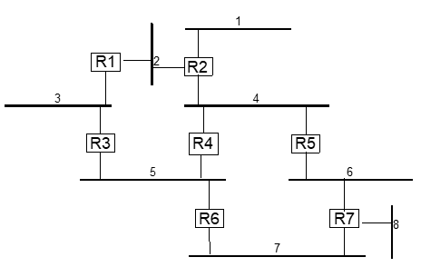
Exercise 7
Use RIP-I with split horizon and poisonous reverse. Use a hop count of 16 to represent infinity. At the steady state, write down the distance vector sent by R2 on subnet 4.

Slide 26
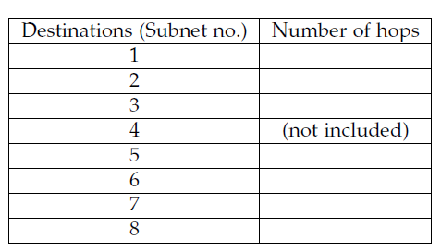
Exercise 7

Slide 27
Path vector
Augment each distance vector entry with a path vector.
  Y advertises to Z about a route to X with a cost of 4 plus a path vector {X,Y}.
  Z advertises to Y about a route to X with a cost of 5 plus a path vector {X,Y, Z}.
  When Y receives the route, it checks whether its identity is in the path vector.
Y
4
1
X
Z
50

Slide 28
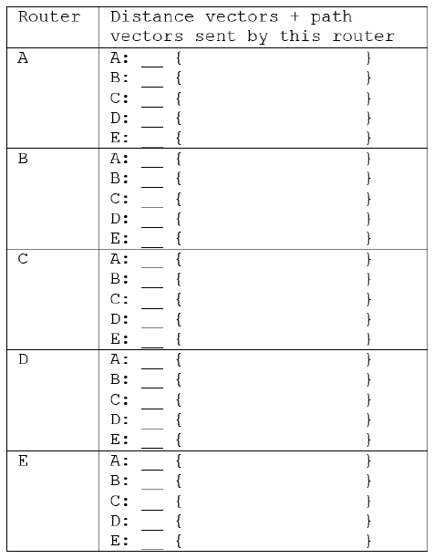
Exercise 8
Write down the distance vector and path vector sent by each router in the network topology on slide 18.

Slide 29
Source tracing
Augment each distance vector entry with the identity of the router immediately preceding the destination, e.g., E-->B
  Trace the route to be B<--C<--D<--E.
1
B
C
7
A
8
2
1
E
D
2

Slide 30
Routing Information Protocol (RIP)
RIP is an implementation of the distance vector approach at the application level.
  Common daemons used on the Unix systems are the programs routed and gated.
  RIP packets are carried over UDP and IP.
Most RIP implementations use hop count (the number of routers traversed) as the cost.
  A hop count of 16 is interpreted as infinity.
Each node is a RIP router, which is generally connected to a number of networks.

Slide 31
RIP-1 messages

Slide 32
Summary for distance vector routing protocols
Internet routing is the “intelligence” of the network layer.
Distance vector routing has been deployed in the intra-domain routing protocols today.
However, it suffers from the slow convergence problem and it is prone to routing loops.
A number of additional mechanisms were added to the basic distance-vector routing, e.g., path vector, etc.

Slide 33
Link state approach
In the DV approach, each router discovers the network topology through the distance vectors received from its neighbors.
In the LS approach, each router discovers the network topology through link state advertisements (LSAs).
  Each router is responsible for discovering its neighbors and the states of the links between them and informs other routers.
  Upon receiving all the link states, a router can form a local view of the entire network.

Slide 34
An example
Routers connected by point-to-point links
  Networks connected to the routers are omitted.
  Link states are generally asymmetric.

Slide 35
After exchanging LSAs with neighbors
For router A

Slide 36
After receiving all LSAs
After the protocol converges, the routers’ link state databases are identical.

Slide 37
Link state routing protocols
Therefore, there are two main parts in a link state routing protocol.
  (Topology dissemination) Construct and maintain a consistent link state database in all routers.
  (Route computation) Each router computes minimum-cost paths to all destinations in the network.

Slide 38
Topology dissemination
Neighbor discovery
  Use Hello protocols to discover neighbors and to elect a designated router on a shared medium.
Bringing up adjacencies in a point-to-point network
  A set of protocols (database description, link state request/update) to synchronize the link state databases of the two routers
On a shared medium, a designated router
  forms adjacency with other routers, and
  responsible for advertising the link states.

Slide 39
Topology dissemination for shared medium

Slide 40
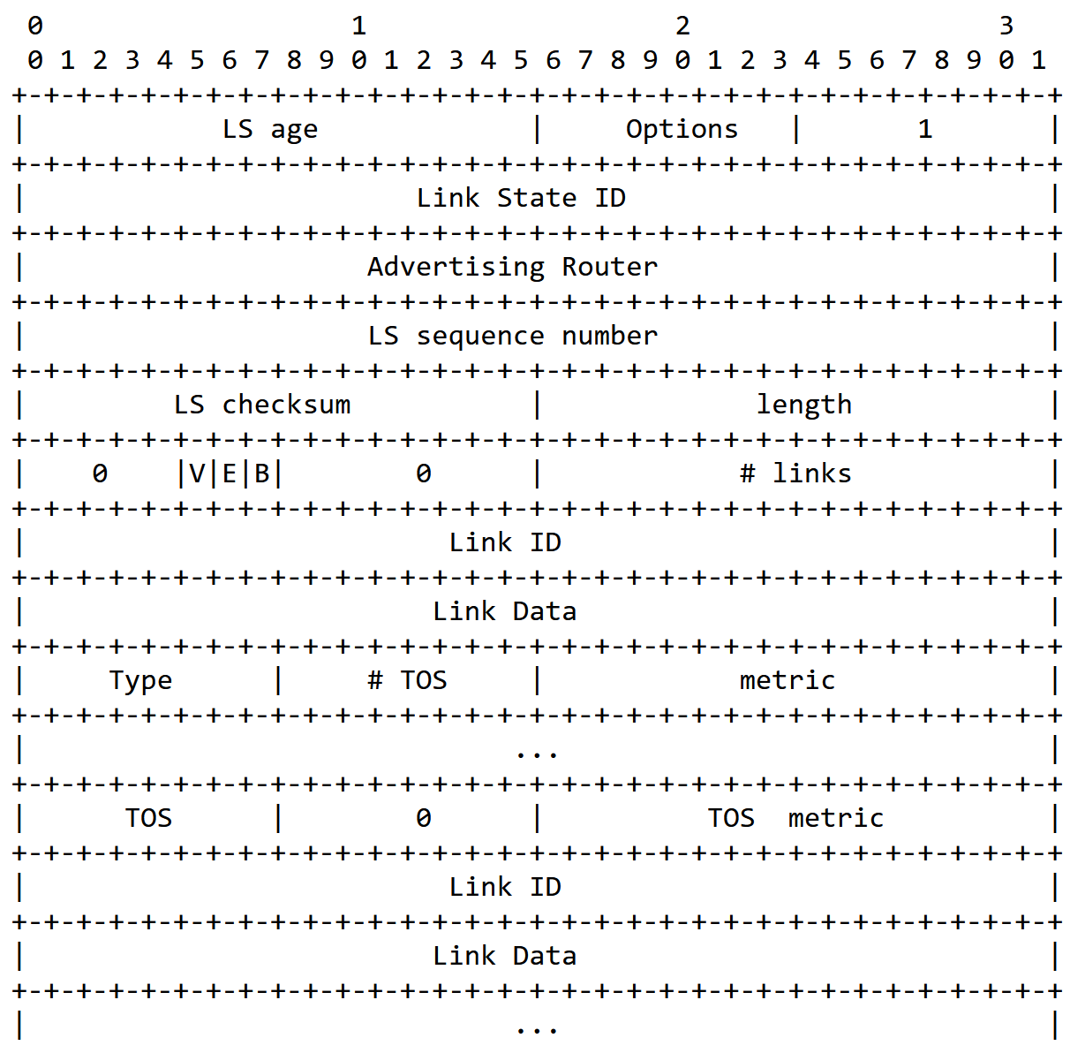
Link state advertisements (RFC 2328)

Slide 41
Exercise 9
Download OSPF_point-to-point_adjacencies.cap from i-Learning.
How many OSPF routers were there?
What is the destination IP address of these OSPF messages?
Take a look at a OSPF Update message. Find out the “links” that were advertised in the message.

Slide 42
Link state advertisements
A link-state router generates a link state advertisement (LSA) when discovering
  a new neighbor router, or
  the cost of the link to an existing neighbor changes (including link failure).
The LSA describes the latest changes in the network topology and must be transmitted to all other routers as soon as possible.
  Dissemination cannot be based on the current routing information. Why not?

Slide 43
An example
If B fails, A needs to update the link state for A→B.
  But the spanning tree computed based on the original topology does not reach all nodes.

Slide 44
Reliable flooding protocol
The advertising router floods an LSA to all other interfaces.
  Other routers forward the LSA to all interfaces except the one that the LSA is received.
To ensure reliability, all LSAs are positive-acknowledged.
  A checksum is used to detect data corruption of an LSA, which covers the entire LSA except for some mutable fields.
  The checksum is used both when the LSA is flooded and kept in the router’s database.

Slide 45
Packet storm prevention
To prevent packet storms from occurring, use some information to differentiate new LSAs from old LSAs.
  Each router must keep the latest LSAs.
  LSAs that are not newer are discarded.
Differentiating between new and old LSAs
  Timestamps with local and global meanings (stamped by the advertising router).
  A combination of sequence number (SN) and age.

Slide 46
LSAs’ sequence numbers and ages
A new LSA is indicated by a larger SN (the advertising router increments the SN for every LSA it sends).
  The age and other information may also be used when the SNs are identical.
Design of the sequence numbering
  Circular SN space (SN wraparounds)
  Linear SN space (no SN wraparounds).

Slide 47
LSAs’ sequence numbers and ages
The SN starts from some value, say 0 (this initial value may be negative).
  The SN space should be large enough, say 32-bit SN space.
When attempting to increment the SN beyond the largest SN,
  Prematurely age the LSA and reflooding it.
  After receiving ACKs from all neighbor routers, send the LSA with the initial SN.

Slide 48
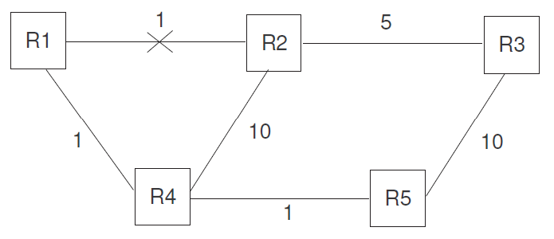
Exercise 10
In a link-state routing protocol, a link failure has to be broadcasted to all other routers to update their link-state databases. A student, however, claims that it is not necessary to disseminate the link failure update to all routers. Instead, only the routers on the restoration path need to be updated. The figure below illustrates this student’s idea. The link between R1 and R2 fails, and the restoration path for R1-R2 is through R4. Therefore, only R1, R2, and R4 will update the link states for R1-R2 to “unreachable.” R3 and R5, on the other hand, are not aware of the link failure.
Use a simple example to illustrate that this scheme will result in a routing loop.
Use a simple example to illustrate that this scheme will result in a non-shortest path.

Slide 49
Route computation
Given the network topology, each router computes minimum-cost paths from itself to other destinations (a spanning tree).
  Use any efficient single-source, shortest-path algorithms, such as Dijskstra’s algorithm.
The link state can be based on any type of service (TOS), such as delay, reliability, etc.
Compute routes for different TOS, and equal-cost paths for load balancing.
The computed routes can be used in source routing or hop-by-hop routing.

Slide 50
An example

Slide 51
The optimality principle
If router E is on the optimal path from router A to router D, then
  the optimal path from router E to router D also falls along the same path.
Given that the link state databases are identical in all routers, each local forwarding decision gives a globally optimal path.
If the link state databases are not identical, can the routers forward packets on an optimal path?

Slide 52
Open shortest path first (OSPF) protocol
OSPF is an implementation of the link state approach.
OSPF calculates separate routes for each TOS.
  When several equal-cost routes to a destination exist, traffic is distributed equally among them.
  The cost of a route is described by a single dimensionless metric.
OSPF allows sets of networks to be grouped together, i.e., areas.
  The topology of an area is hidden from outside.

Slide 53
OSPF
OSPF enables the flexible configuration of IP subnets.
  Each route distributed by OSPF has a destination and mask.
  Two different subnets of the same IP network number may have different sizes.
All OSPF protocol exchanges are authenticated.
Externally derived routing data is passed transparently throughout the OSPF network.

Slide 54
An OSPF network example
A cost is associated with the output side of each router interface.
Three kinds of nodes:
  Router (transit)
  Network (transit), e.g., N8 and N9
  Stub network (nontransit), e.g., N1 and N2
N3, 6, 8, 9 are broadcast networks.
RT5 and RT7 are AS border routers.
N12-N15 are external networks, and the routes to N12 are advertised by both RT5 and RT7.

Slide 56



Slide 57
Link state representations: routers and LANs

Slide 58
Shortest-path tree rooted at RT6
A shortest path tree to the 11 routers, 15 networks, one host and Ia and Ib for the point-to-point link RT6-RT10.
Links without labels have costs of 0, e.g., N3 to R1, 2, 4.
RT6 has a link to address Ib (destination) and another link to RT10 (transit).
  Numbered vs unnumbered point-to-point links
RT10 uses RT7 to reach external network N12.
Only the next hop to the destination is used in the IP forwarding.

Slide 60
RT6’s forwarding table for internal destinations

Slide 61
RT6’s forwarding table for internal destinations

Slide 62
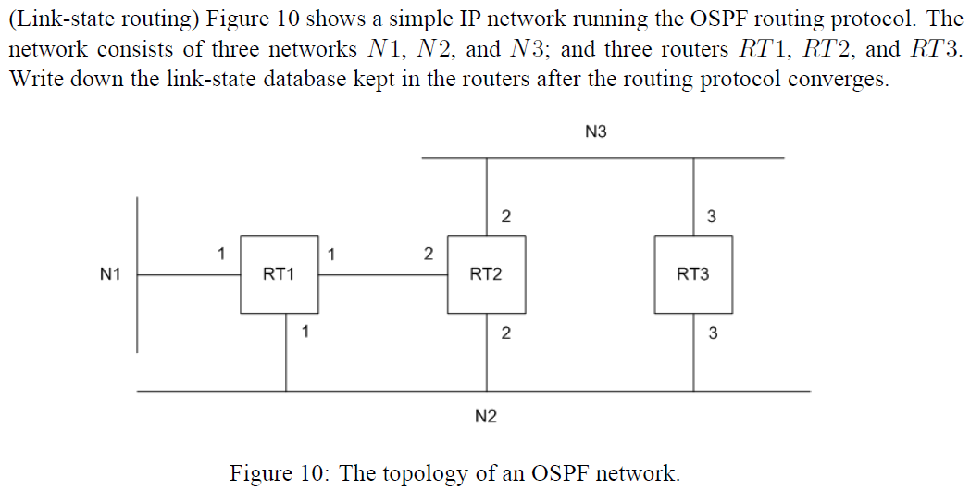
Exercise 11

Slide 63
OSPF areas
OSPF uses the concept of areas to define the routing environment.
  An area is a logical collection of networks, identified by a 32-bit ID.
  All routers belonging to the same area disclose complete information about all networks within that area.
  There is a special area that must be defined for all OSPF domains---the backbone area (0.0.0.0).
The backbone is responsible for distributing routing information between areas.

Slide 64
Inter-area routing
Internal, area border, backbone, AS boundary routers
Inter-area routing: from a source to
  an area border router to
  a backbone path between the source and destination areas to
  another intra-area path to the destination
The correct area border to use for exiting the source area is chosen exactly the same way as how external routers are chosen (e.g., N12).

Slide 66
Advertising link states into Area 1
Internal destinations: N1-N4
Area border routers RT3 and RT4 advertise into Area 1 the distances to all destinations external to the area.
RT3 and RT4 must also advertise into Area 1 the locations of the AS boundary routers RT5 and RT7.
Finally, external advertisements from RT5 and RT7 are flooded throughout the entire AS, including Area 1.

Slide 69
Exercise 12
Considering the backbone database on the last slide, draw a spanning tree rooted at RT6 for only internal networks (i.e., N1-N4, N6-N8, and N9-N11) which is the result of running the OSPF protocol.

Slide 70
Conclusions for link state routing protocols
LS protocols have been deployed for intra-domain routing, such as IS-IS and OSPF.
LS protocols rely on reliable mechanisms to update link states of the network in all routers.
Compared with the DV approach, LS protocols are more complex to design and also more difficult to manage.
While the LS approach scales better than the DV approach, the LS still cannot be used in interdomain routing.

Slide 71
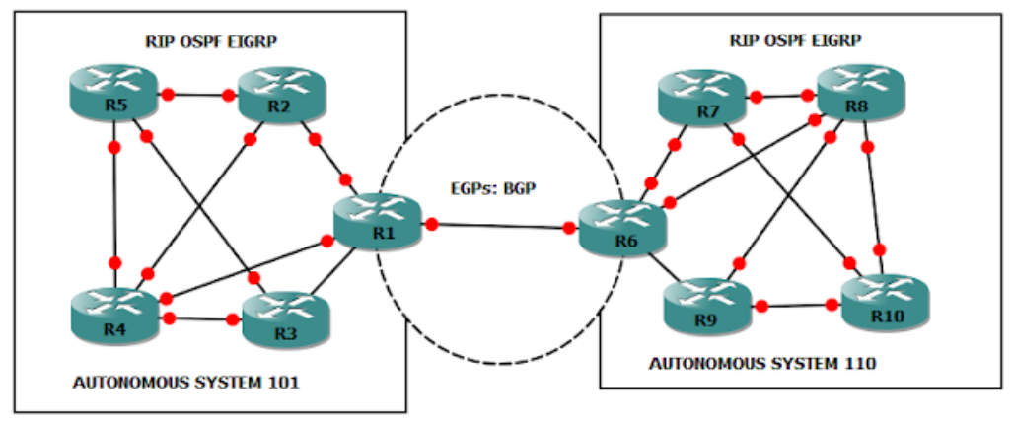
Interdomain routing
Source: https://dzone.com/articles/introduction-of-bgp

Slide 72
Requirements for interdomain routing
Accuracy
  Accurately reflect the forwarding states of the network (e.g., avoiding forwarding loops)
  Local changes in physical networks or policies cause the routing system to recompute the new routing states.
Scalability
  Static nature: the number of routing entries, the number of AS, etc.
  Dynamic nature: routing update rates, adding and withdrawing routes, etc.

Slide 73
Requirements for interdomain routing
  The growth trend in the inter-domain routing space do not appear to have well-defined upper limits.
Policy expressiveness
  Determining a path and the best path
  Ingress routing policies: how a domain learns and selects routes.
  Egress routing policies: how a domain announces routes to its adjacent neighbors.

Slide 74
Requirements for interdomain routing
Robust predictable operational characteristics
  Minor variations in the state of the network should not cause large-scale instability across the network.
  Recomputation of the routing states must always halt and the halting point must be reached quickly.
Efficiency
  The routing system should be efficient in terms of the bandwidth and processing.
  Trade off with the accuracy requirement.
The security of the routing information must be reasonably protected.

Slide 75
Possible approaches for inter-domain routing
Distance vector approach
  Exterior Gateway Protocol (EGP)
  Each EGP router announces reachability information (list of destinations and “distances”)
  Designed for tree-structured topology, no policy routing support, slow convergence, etc.
Link state approach
  Interdomain policy routing (IDPR)
  Each IDPR maintains an AS-level map.
  Setting a path between a source and a destination.

Slide 76
Border gateway protocol version 4 (BGP4) – RFC4271
Exchange routes with neighbor routers in other AS’s.
No periodic routing updates to ensure the neighbors’ liveliness.
Attach a path vector to each route for routing loop detection.
Attach a path with different attributes to facilitate local routing policies.
Provide facilities for route aggregation.

Slide 77
BGP4 speakers, peers, and sessions
Two BGP speakers (hosts or routers) may establish a BGP session between them.
  If the two speakers are from two different AS’s, they must be connected directly.
A BGP session uses TCP for transport.
  The two sides initially exchange their routes.
  The TCP connection assures to each side that the other side is alive.
  BGP therefore does not require periodic route refreshing.
  BGP has its own keepalive messages.

Slide 78
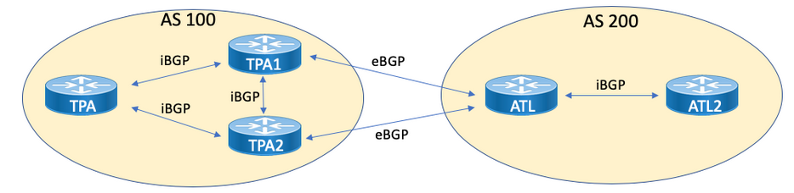
BGP4 speakers, peers, and sessions
Source: https://www.kwtrain.com/blog/bgp-pt1

Slide 79
Exercise 13
Fetch a BGP Wireshark capture from i-Learning.
How many kind of BGP messages are shown in the trace and what are their purposes?
What are the routes being updated?

Slide 80
BGP4 protocols
BGP4 messages serve the following purposes:
  Open a BGP message with a neighboring BGP speaker (OPEN).
  Inform the neighbor about new routes that are active (UPDATE).
  Inform the neighbor of old routes that are no longer active (UPDATE).
  Inform the neighbor that the connection is still viable (KEEPALIVE).
  Report unusual conditions before terminating the TCP connection (NOTIFICATION).

Slide 81
Route updates
When a BGP speaker A advertises a route to its neighbor, the information is considered valid until
  A explicitly advertises that the information is no longer valid (route withdrawals), or
  the BGP session itself is lost.
Each update message can include a number of prefixes that share all attributes.

Slide 82
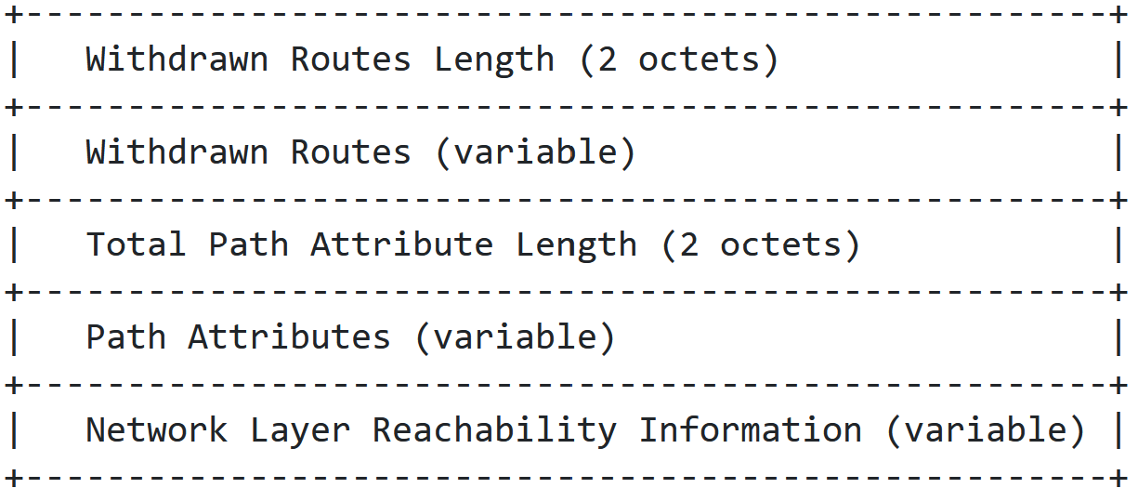
BGP update messages

Slide 83
Exercise 14
Go to https://bgp.he.net/ and enter a CYCU IP address. How many routes are found?
Go to https://stat.ripe.net/widget/bgplay and visualize the route to a CYCU IP address. How many upstream ASes does the TANET AS have and who are they?

Slide 84
Exercise 15
Go to https://lg.he.net/ to examine the BGP routes for a CYCU IP address from routers at different parts of the world.
Compare the AS path vectors announced in the routes with the AS paths found in the last exercise.

Slide 85
Internal and external BGP sessions
All BGP speakers representing the same AS must give a consistent image of the AS to the outside.
  Internal BGP (I-BGP) sessions vs. intradomain routing protocols.
  To avoid routing loops, each BGP speaker can only advertise the routes it has learned from external BGP (E-BGP) sessions to other internal speakers.
There are two types of BGP sessions:
  I-BGP: Exchanging routes within the same AS.
  E-BGP: Exchanging routes with another AS.

Slide 86
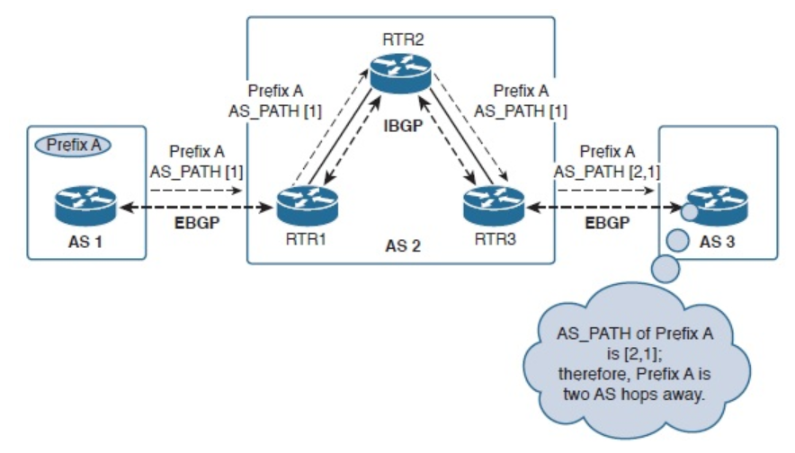
Internal and external BGP sessions
Source: https://www.networkcomputing.com/data-centers/bgp-basics-internal-and-external-bgp

Slide 87
Routing policies
BGP provides the capability for enforcing policies based on various routing preferences and constraints.
  Policies are provided to BGP in the form of path attributes.
A multihomed AS can refuse to act as a transit AS for other ASs.
  It does so by only advertising routes to destinations internal to the AS.
A multihomed AS can become a transit AS for a restricted set of adjacent ASs.
  It does so by advertising its routing information to this set of ASs.

Slide 88
Routing policies
An AS can favor or disfavor the use of certain ASs for carrying transit traffic from itself.
An AS can minimize the number of transit ASs.
  Shorter AS paths are preferred over longer ones.
Fundamental to BGP is the rule that an AS advertises to its neighboring ASs only those routes that it uses.

Slide 89
Route attributes
In BGP, the route to a prefix is attached with a number of attributes for policy routing
  Well-known mandatory: ORIGIN, AS-PATH, NEXT-HOP
  Well-known discretionary: LOCAL_PREF and ATOMIC_AGGREGATE
  Optional nontransitive: MUTI_EXIT_DISC
  Optional transitive: AGGREGATOR, COMMUNITY

Slide 90
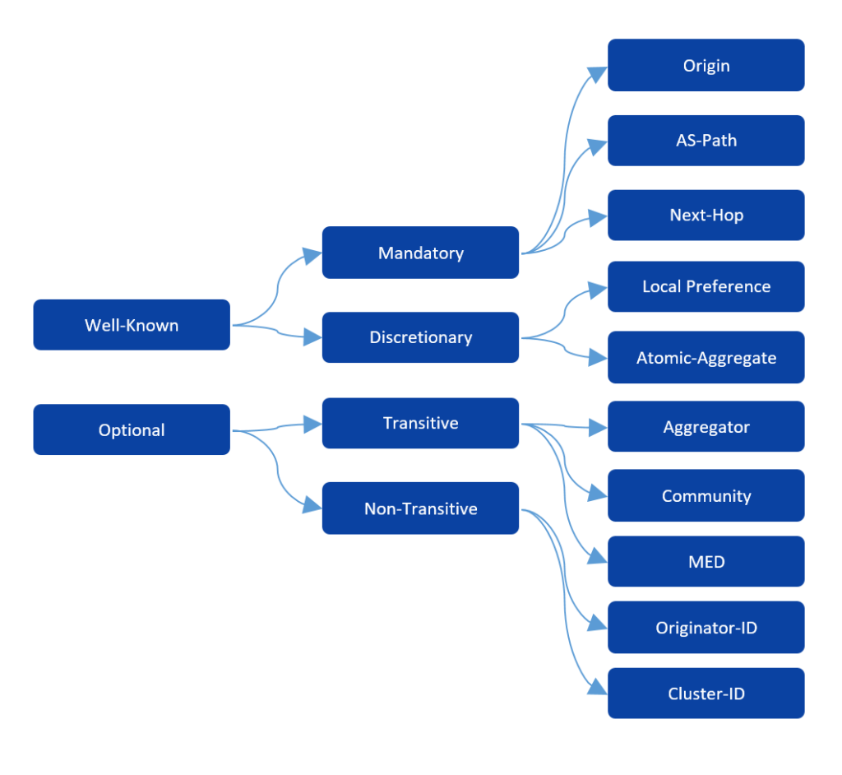
Route attributes
Source: https://www.routecloud.net/blog/bgp-configuration-nokia-cisco-juniper-huawei-part-1/

Slide 91
The Origin attribute
The ORIGIN attribute describes how a prefix came to be routed by BGP at the origin AS.
  IGP (routes learned from an IGP)
  EGP (routes learned from EGP, a predecessor of BGP)
  INCOMPLETE

Slide 92
The AS-PATH attribute
The AS-PATH attribute contains the numbers of AS’s through which the announcement for the prefix has passed.
  Detect routing loops and aid routing decisions.
Two path segment types: AS-SEQUENCE and AS-SET
  (Sequence(1, 2, 3)) and (Set(1, 2), Sequence(3))
AS1
AS1
AS2
AS3
AS3
AS2

Slide 93
NEXT-HOP attribute
The NEXT-HOP attribute indicates the address of the next hop node, which the data packets should be sent to for the prefix.
UPDATE message through BGP
140.12.0.0/16
R1
R2
R3
AS 1
AS 2
Traffic to 140.12.0.0/16
Note that R1 and R2 are BGP speakers but R3 is not.

Slide 94
MUTI_EXIT_DISC attribute
If two ASes connect to each other in more than one place, this attribute helps select an optimal link to a particular prefix in or behind that AS.
Link A
AS 3
AS 1
AS 2
Link B
AS 4

Slide 95
MUTI_EXIT_DISC attribute
The BGP speaker in AS2 on link A may advertise the routes to AS3 and internal prefix that is closer to link A with a smaller MUTI_EXIT_DISC value.
One AS sets the MUTI_EXIT_DISC values and the other uses the values to decide the best route.
The MUTI_EXIT_DISC attribute is therefore more suitable for provider-to-subscriber, not for provider-to-provider.

Slide 96
LOCAL_PREF attribute
In this example, AS4 receives the route to 138.39.0.0/16 from both AS2 and AS3.
The MUTI_EXIT_DISC attribute cannot be used for selecting the path.
  There is only a single link between AS2 and AS4 and between AS3 and AS4.
  AS4 wants to control the path selection itself.
AS4 can implement its own preference by configuring the value of the LOCAL_PREF attribute which is used only in I-BGP sessions.

Slide 97
The LOCAL_PREF attribute
AS1
AS2
AS3
AS4
138.39.0.0/16

Slide 98
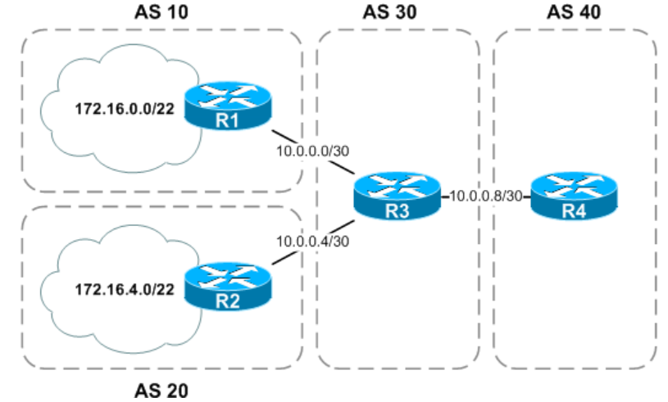
The AGGREGATOR attribute
R3 aggregates the routes into a single route 172.16.0.0/21.
Source: https://packetlife.net/blog/2008/sep/19/bgp-route-aggregation-part-1/

Slide 99
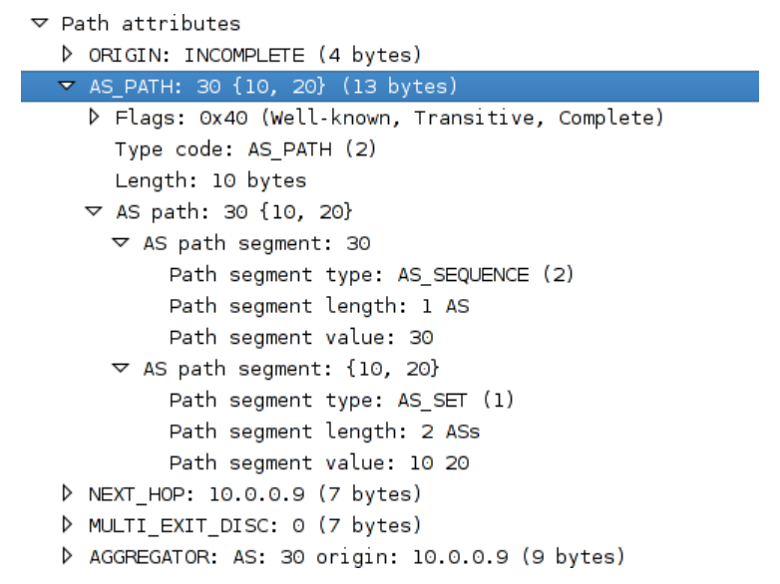
The AGGREGATOR attribute
Source: https://packetlife.net/blog/2008/sep/19/bgp-route-aggregation-part-1/

Slide 100
Route selection
A BGP speaker
  evaluates different paths from itself to a set of destination covered by an address prefix,
  selects the “best” one,
  applies appropriate policy constraints,
  and then advertises it to some or all of its BGP neighbors.
The path selection can be based on
  Information explicitly present in the full AS path.
  A combination of information that can be derived from the full AS path and information outside the scope of BGP.

Slide 101
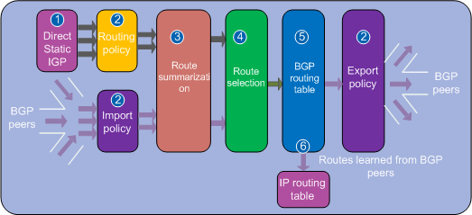
Route selection
Source: https://support.huawei.com/enterprise/en/doc/EDOC1100055018/70e83769/bgp-route-selection-rules (no longer available)

Slide 102
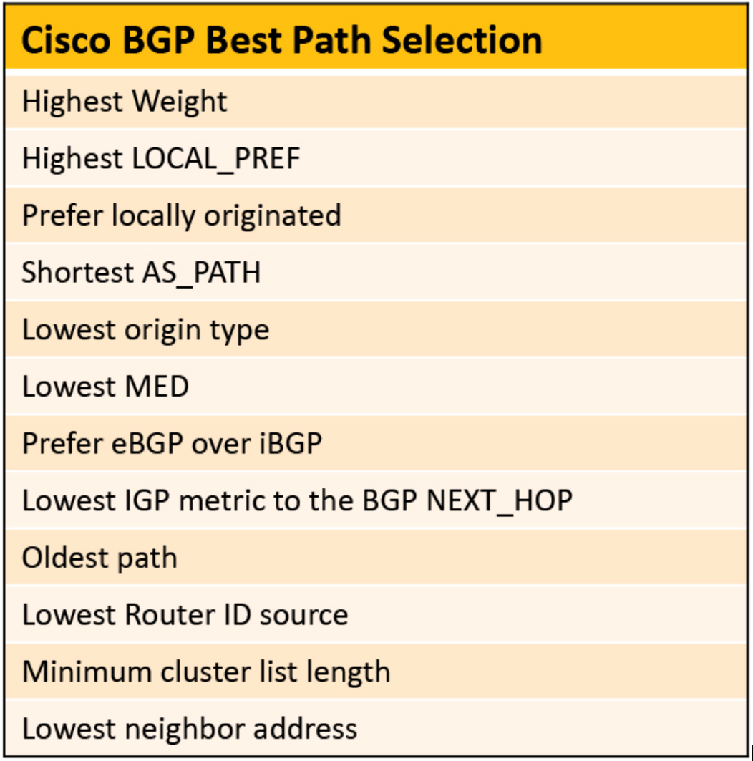
A Route selection example
Cisco’s proprietary BGP attribute
Source: https://www.kwtrain.com/blog/bgp-pt2

Slide 103
Summary
BGP provides a very effective interdomain routing solution for the last 3 decades.
BGP achieves a number of requirements in a single protocol, such as routing loop detection, support for policy routing, efficiency, etc.
Many new developments were made for BGP after RFC 1771, especially the security of BGP.

Slide 104
References
Larry Peterson and Bruce Davie, Computer Networks: A Systems Approach, Second Edition, Morgan Kaufmann, 2000.
J. Stewart III, BGP4: Inter-Domain Routing in the Internet, Addison Wesley, 1999.
http://bgp.potaroo.net/cidr/
G. Huston, “An Examination of the Internet’s BGP Table Behaviour in 2001.”
C. Huitema, Routing in the Internet, Prentice Hall PTR, Second Edition, 1999.
G. Huston, “Scaling Inter-Domain Routing--A View Forward,” The Internet Protocol J., 2001.
Y. Rekhter and P. Gross, “Application of the Border Gateway Protocol in the Internet,” RFC 1772, March 1995.

